Slide 1
Subset Selection
UIUC ECON 490: Applied Machine Learning in Economics

Slide 2
Linear Model Selection
Back to Regression!

Slide 3
Why Linear Regression?
If true relationship approximately linear, OLS has low bias
Often the case in economics
Theory motivated
Interpretability
First-order effects
Subset methods identify best model based upon performance statistic

Slide 4
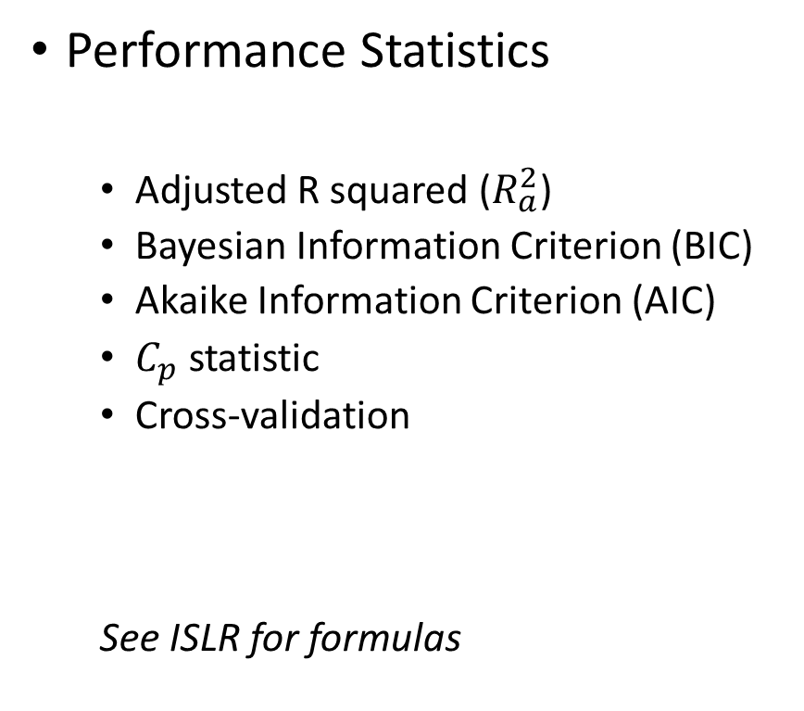
Haven’t we done this already?
Backward selection
p-values
Best subset selection
Backward stepwise selection
Forward stepwise selection
Performance Statistics
Adjusted R squared ($R_{a}^{2}$)
Bayesian Information Criterion (BIC)
Akaike Information Criterion (AIC)
$C_{p}$ statistic
Cross-validation
See ISLR for formulas

Slide 5
Best Susbet Selection
Test them all UIUC style

Slide 6
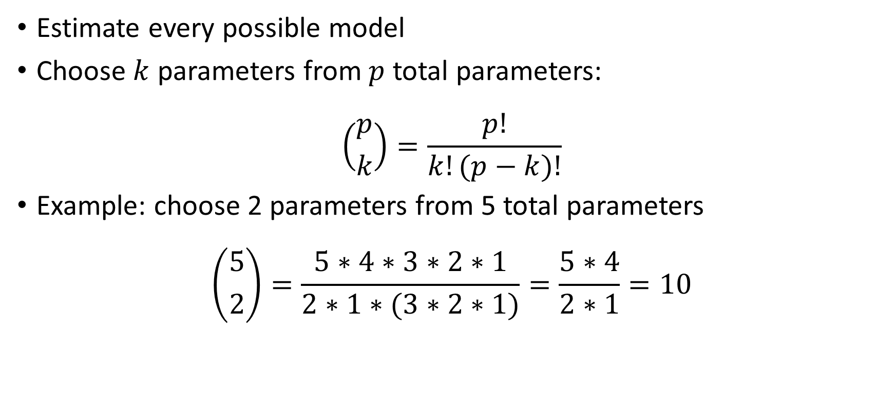
Best Subset Selection
Estimate every possible model
Choose $k$ parameters from $p$ total parameters:
$$\left({p \atop k}\right)=\frac{p!}{k!(p−k)!}$$
Example: choose 2 parameters from 5 total parameters
$$\left({5 \atop 2}\right)=\frac{5∗4∗3∗2∗1}{2∗1∗(3∗2∗1)}=\frac{5∗4}{2∗1}=10$$

Slide 7

Best Subset Selection Total Models
$$\sum_{k=0}^{p}{\left({p \atop k}\right)}=\sum_{k=0}^{p}{\frac{p!}{k!(p−k)!}}=2^{p}$$
If we have only 10 variables
$$2^{10}=1024$$
Does not include CV or repeated CV

Slide 8
Stepwise Selection
Backward and Forward

Slide 9
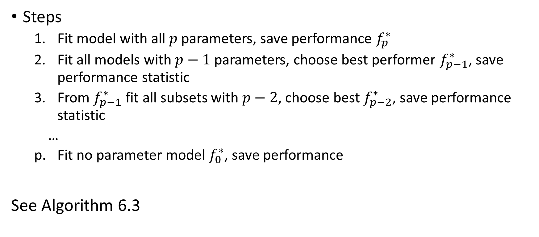
Backward Stepwise Selection
Steps
Fit model with all $p$ parameters, save performance $f_{p}^{∗}$
Fit all models with $p−1$ parameters, choose best performer $f_{p−1}^{∗}$, save performance statistic
From $f_{p−1}^{∗}$ fit all subsets with $p−2$, choose best $f_{p−2}^{∗}$, save performance statistic
…
Fit no parameter model $f_{0}^{∗}$, save performance
See Algorithm 6.3

Slide 10
Forward Stepwise Selection
Steps
Start with all 1 parameter models, choose best, save.
Try all two parameter models that have the parameter chosen in step 1
Try all three parameter models that have the parameters chosen in step 2
…
Fit the full model
See algorithm 6.2

Slide 11

Stepwise Selection Total Models
$$1+\sum_{k=0}^{p−1}{(}p−k)=1+\frac{p(p+1)}{2}$$
For 10 parameters:
$$1+\frac{10(11)}{2}=56$$

Slide 12
Comparison
 | Number of Models
N Parameters | Stepwise | Best
5 | 16 | 32
10 | 56 | 1,024
20 | 211 | 1,048,576

Slide 13
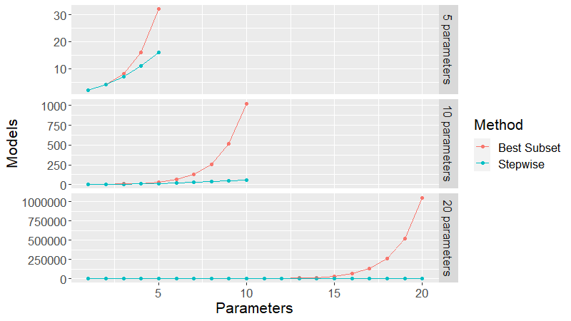
Visually…

Slide 14
Model Selection Method Comparison
Probably won’t choose the same
In general, choose the most parsimonious model
Look for kinks in performance statistics

Slide 15
To Do
Do
Lab 6.5
Read
Chapter 6.2

